Slide 1
9. Academic poster style

Slide 2
Purpose of posters
  Academic posters are becoming a common approach to communicating and presenting research. Traditionally this has been the pursuit of scientific disciplines;
  Posters act as a medium to advertise your work;
  They enable you to summarise your work – and to get your main points across to as many people as possible;
  Act as a conversation starter - they engage people in discussion about your work.

Slide 3
Thinking about your poster
Key questions need to be answered before you get to the design stage. These are:
  Who is your audience?
    Professionals, academics, the general public – the language used and messages given out need to meet the needs of your audience
  What is your hook?
    Catchy titles provide the feature that may draw your audience in to peruse your poster. Is the message clearly stated and will it capture the attention of your audience?
  What is the purpose of your poster?
    Consider what messages you wish to communicate and the audience receiving the messages. Remember you need to present a coherent snapshot of your research
  What are the guidelines for your poster?
    Refer to your brief
  What is your message?
    Effective posters deliver clear messages, content is highly visual

Slide 4
Planning your poster
An effective poster should be:
  Legible from a distance of about two meters away,
  Use a title that captures the attention of your audience,
  Your title should be readable from about 3 - 4 meters away.
  Use the right language for the right audience,
  Avoid clipart wherever possible – due to pixel quality the resolutions may not suit your poster, images may blur.,
  Have enough ‘white’ space – this aids readability,
  Expect to work for a period of about five weeks on your poster!! This will be intermittently, so don’t panic but give yourself plenty of time to proof and revise accordingly.

Slide 5
Things to think about
People read posters from left to right and top to bottom – consider your layout – portrait/landscape. Be guided by your conference brief.
Using too much jargon may confuse your audience, unless they are specialists in your field and already know the jargon.
What message will readers take home with them? – what will they remember about your work?
Colour schemes – think about the tones and hues, avoid large swathes of garish colours.
Word count – a typical poster will have between 300 – 500 words, audience dependent.

Slide 6
Font – Avoid using more than two different fonts. Choose a font such as Arial.
Use a good balance of text, pictures, charts and graphics. The text should support your images and vice versa.
The size of your poster and the orientation you will use.
Line spacing and text justification – left justification maybe easier to read.
Getting it printed – matt/glossy to laminate or not to laminate – a matt finish reduces glare. Laminated posters travel better so this might be worth considering – refer to conference brief.

Slide 7
Title
Presenter details and affiliations
Introduction
Results
Image
Method
Conclusion
Image/table/graphic
Image
References

Slide 8

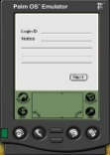
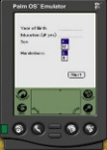
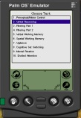
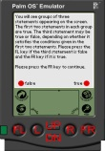
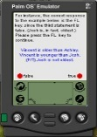
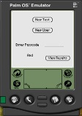
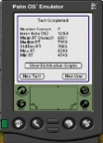
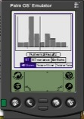
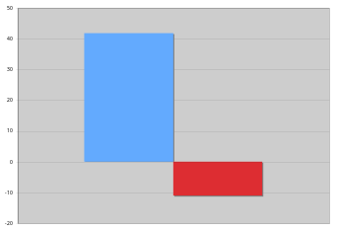





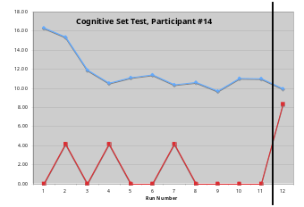


Quick Assessment of Basic Cognitive Function: A ‘Blood-Pressure Cuff’ for the Mind
Jennifer M. Shephard, Julia B. LeSage, Stephen M. Kosslyn
Harvard University, Department of Psychology, Cambridge, MA
Research supported by NASA cooperative agreement NCC 9-58 with the National Space Biomedical Research Institute
Goals
1. To design a quick and easily self-administered cognitive test battery, the MiniCog Rapid Assessment Battery (MRAB), for immediate assessment of current cognitive functioning.
2. To design software, MiniCog and MiniCogWriter, for scripting psychological tests and experiments to run on the Palm OS® and provide instantaneous feedback to user.
Significance
1. Addresses Critical Path Risks 19, 20, and 21 (human failure due to sleep/circadian rhythm disruption, interface/habitat/workload design problems, and neurobehavioral dysfunction); can be used
• To assess effects of variables such as sleep loss on key cognitive and perceptual processes (CQ 6.08);
• To assess effects of drugs, training, and other countermeasures on cognitive and perceptual processes;
• For self-assessment by astronauts of their “current cognitive state” (CQ 6.11, 6.15, 6.20).
2. Earth applications include use by truck drivers, surgeons, business travelers, air traffic controllers, mountain climbers, mission commanders, and others whose long hours, unusual shifts, or stressful environments may affect performance.
Tests
What the user sees…
If login ID is new…
If login ID is in system already…
Because participants reach baseline after about 7 practice runs, we compared their performance during the early morning session with their average performance across the 3 practice runs prior to this session (corresponding to practice runs 8-10, 9-11, or 10-12, depending on the number of runs participants were able to complete during the practice sessions).
With the small number of participants included in these preliminary analyses, there were no statistically significant results except for the difference between the groups in response time performance on the Vigilance test; participants in the caffeine condition improved relative to baseline, while those in the decaf condition performed more poorly.
. . .
Change from Baseline of RT on Vigilance Test During 5am Session
This difference is based on 16 participants and is statistically significant (p = .02). There was no significant difference between the groups in change in error rate.
Question
Does fatigue cause poorer performance (slower response times and/or more errors) selectively on the MRAB tests compared to baseline, and does caffeine ameliorate this effect?
Participant characteristics
• Approximately 48 participants will be tested, equal numbers of males and females.
• Harvard students, between the ages of 18 and 30.
• Psychologically and physically healthy.
• Non-smokers.
• Regular consumers of caffeine who drink no more than 3 caffeinated beverages per day.
Methods
• Participants practice MRAB tests a total of 10 to 12 times during four one-hour sessions between 9:00 AM and 3:00 PM, within a two-week period.
• At the end of the two weeks, participants are tested in a 5:00 AM session.
• All participants are given one cup of coffee (approx. 300 ml) prior to performing the early-morning tests; half receive caffeinated (approx. 150mg caffeine) coffee and half receive decaf (random and double-blind).
• Participants fill out questionnaires and other paperwork for 30 minutes after consuming coffee and prior to beginning MRAB.
Results
Data collection is still underway (approximately 22 participants have been tested so far), but data from a subset of the tested participants (16) is presented here.
Depending on the test, participants generally reach a baseline performance level after approximately 7 practice runs; see example performance curve below.
RT change (msecs)
Caffeine Group
Decaf Group
Perceptual Reaction Time - Users must push the key corresponding to the location of a small oval on screen (squares represent different Palm screens).
In addition, some trends were apparent; for instance, both groups appear to have slower Mental Rotation RTs during the early morning session, and faster Cognitive Set Switching and Perceptual Reaction Time RTs during this session -- but these results could be confounded by speed-accuracy tradeoffs.
Final analyses will include “throughput” as a performance measure (to take speed-accuracy tradeoffs into account) as well as response time variance. Participants’ subjective fatigue, objective hours of sleep prior to 5am session, and reported stress levels during all sessions will be included as covariates.
Vigilance (Attention) - Users must respond with one key for random and infrequent targets and another key for distractors.
4 4 4 4 4 (incongruent)
5 5 5 5 5 (congruent)
6 6 6 6 (incongruent)
Filtering (Attention) - Users must indicate the number of digits on the screen; sometimes the number of digits and their meaning are congruent; on other trials they are not.
Divided Attention - Users must press one key for items of a particular shape or shade, and another key for items of another particular shape or shade.
Projects planned for upcoming year
1. Continue validation of MRAB under stressful conditions
• Comparison with other test batteries (e.g., WinSCAT [Wyle Laboratories]);
• Use performance on MRAB to predict performance on an ecologically valid task (flight simulator) under stress;
• Evaluate the effects of performance anxiety (e.g., public-speaking stress) on MRAB;
• Continue collaborations with Dinges (sleep deprivation) and Lieberman (high-altitude and hockey-team head injury studies) laboratories.
2. Extend MiniCog software to
• Allow users to predict their performance just before and after completing a test (but prior to seeing their results);
• Allow users to add notes or comments at the end of a test;
• Include throughput as an automatically calculated performance measure;
• Require two key-presses to exit the program (because users sometimes pressed an exit key by mistake);
• Automatically present the next test on the list, instead of requiring users to choose (because they tend to forget which ones they’ve completed);
• Include better randomization features for stimulus presentation.
3. Continue discussions with collaborators about how to improve MiniCog user interface and possible additional tests to include.
Verbal Working Memory - Users must indicate which stimuli (presented one at a time, not in a row) are the same as the stimulus that appeared “two back.”
Spatial Working Memory - Users must indicate which stimuli are in the same location as the stimulus that appeared “two back” (boxes indicate separate Palm screens).
Cognitive Set Switching - Users must indicate which letter in each series of four does not belong; criterion for categorizing “odd man out” switches every 3 to 7 trials.
Response Time
Run # 12 is the early morning session. This participant had decaffeinated coffee.
Mental Rotation (Problem-solving) - Users must decide whether two objects are the same or are mirror images.
Error Rate
Verbal Reasoning (Problem-solving) - Users must decide whether the third statement in series is true or false given information in the first two (see example on Palm screens in the center panel of this poster).
Morning session

Slide 9
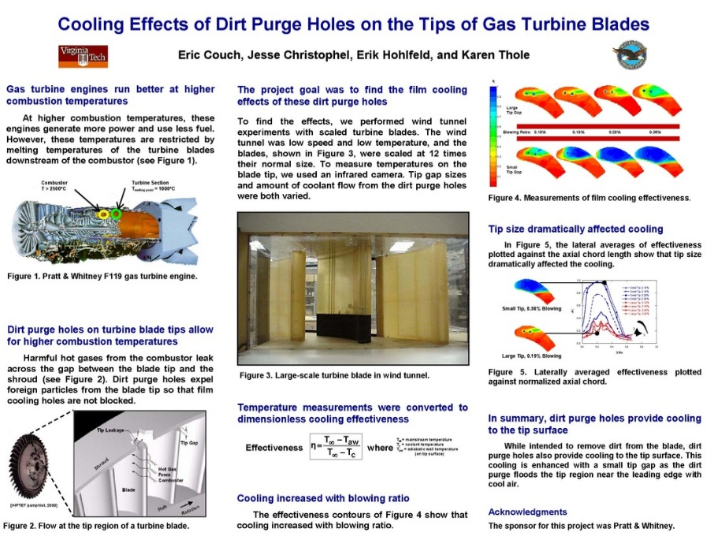

Slide 10
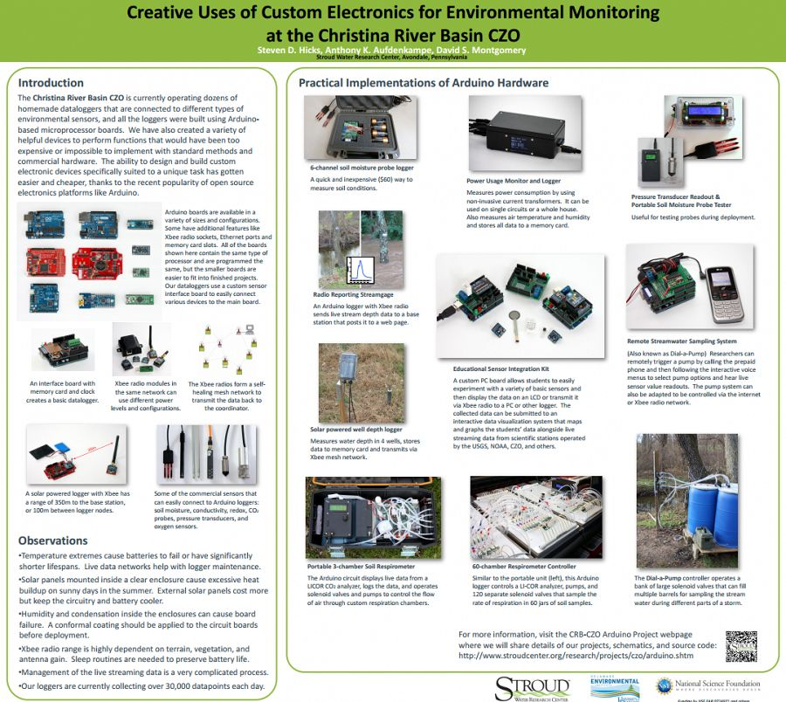

Slide 11
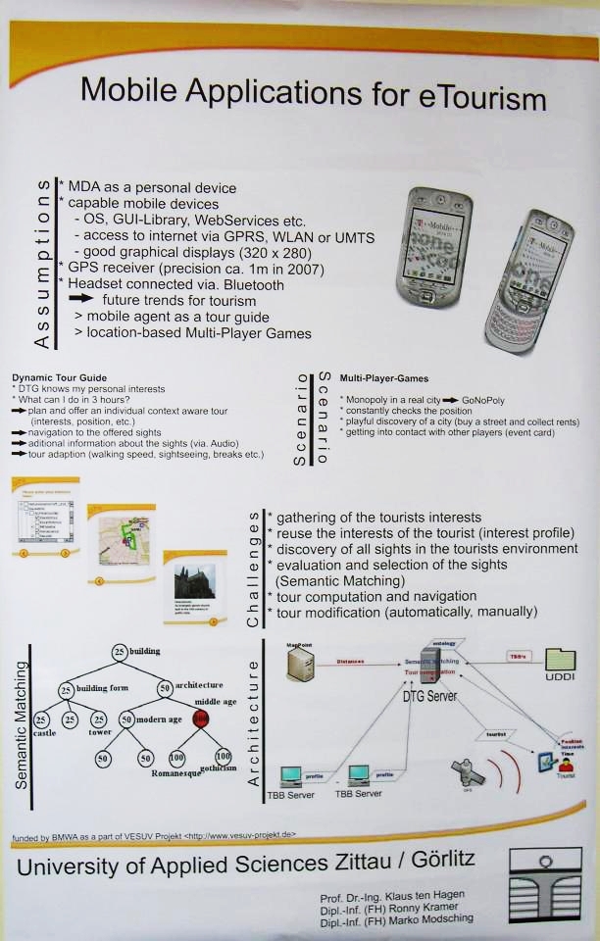

Slide 12
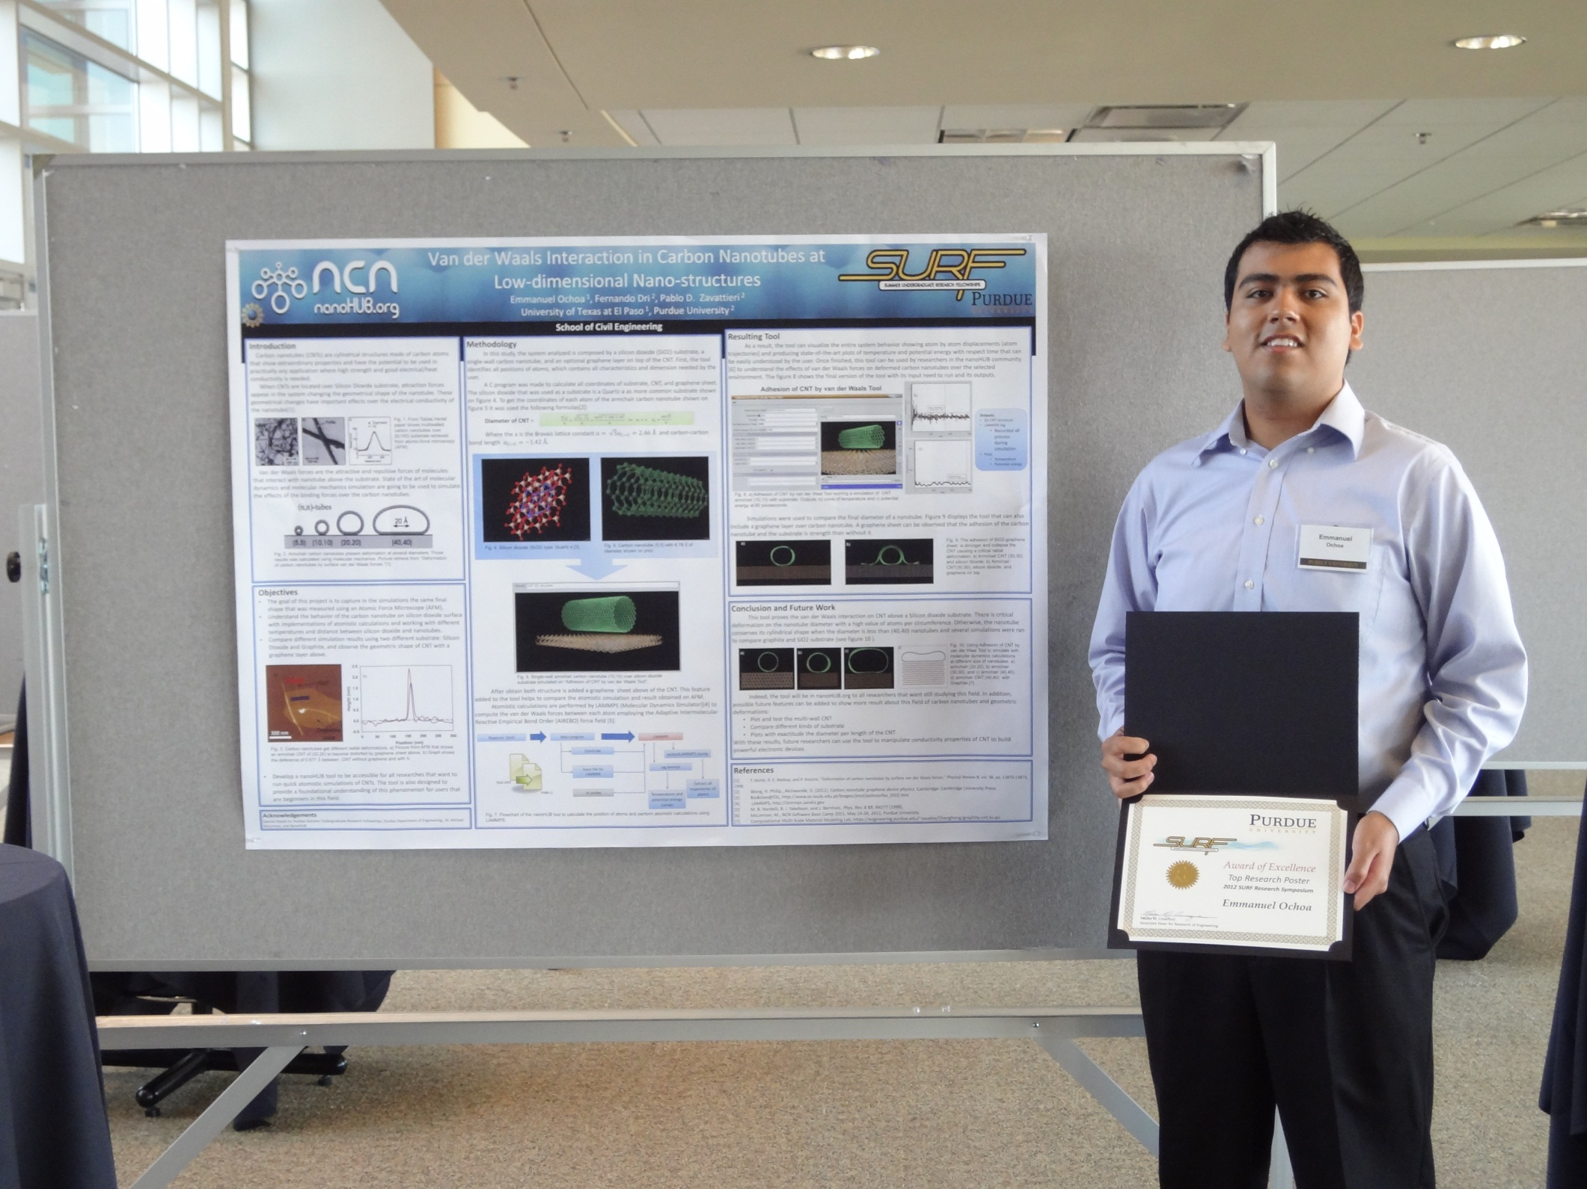

Slide 13
